Slide 1
MEDIUM RANGE FORECAST
MAPUTO- MOZAMBIQUE

Slide 2
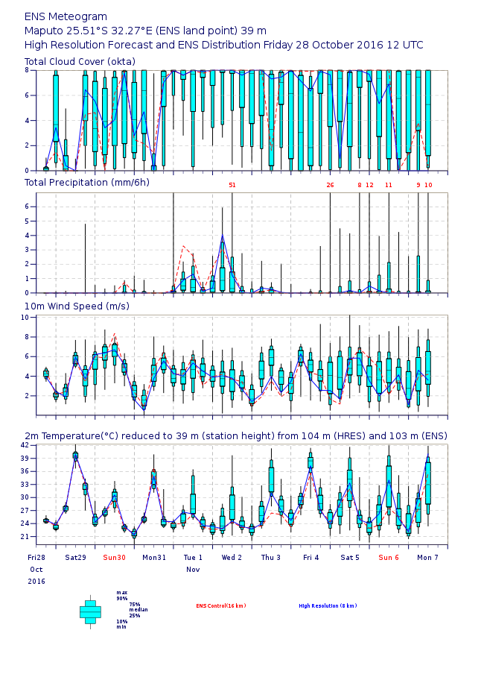
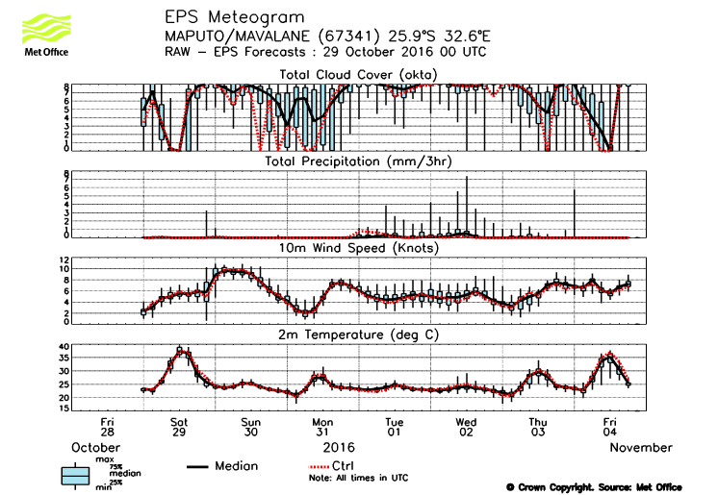
EPSgrams

Slide 3
Sunday
Cloudiness over the area is expected to be
Mostly Overcast
Low chance of rainfall
Wind will expected to range from 1.8 m/s up to 7m/s
Minimum Temperature is expected to be expected to be 20⁰C
Maximum Temperature is expected to be expected to be 32⁰C

Slide 4
Monday
Cloudiness over the area is expected to be
Broken to overcast
No rainfall
Wind will expected to range from 1 m/s up to 6m/s
Minimum Temperature is expected to be 21⁰C
Maximum Temperature is expected to be 36⁰C

Slide 5
Tuesday
Cloudiness over the area is expected to be
Broken to scatter cloud
Low chance of rainfall
Wind will expected to range from 1 m/s up to 7m/s
Minimum Temperature is expected to be 22⁰C
Maximum Temperature is expected to be 27⁰C

Slide 6
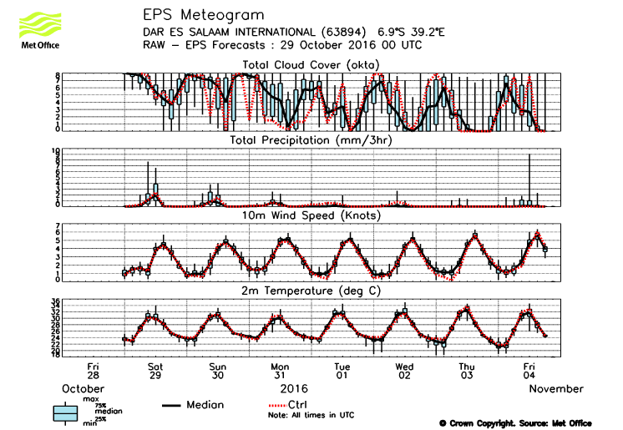
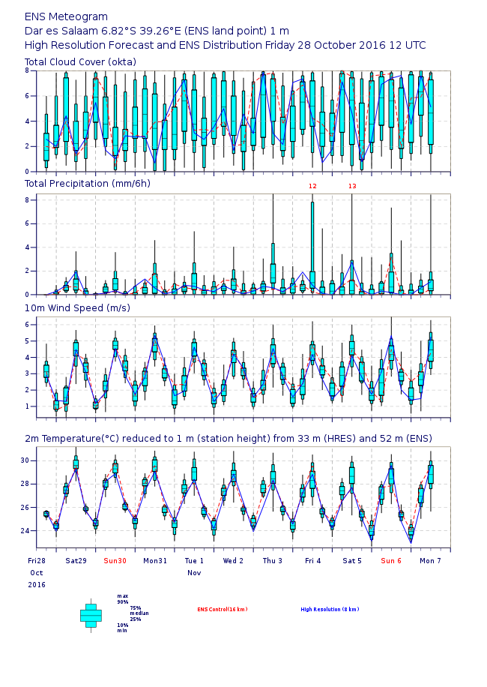
DAR ES SALAAM

